Slide 1
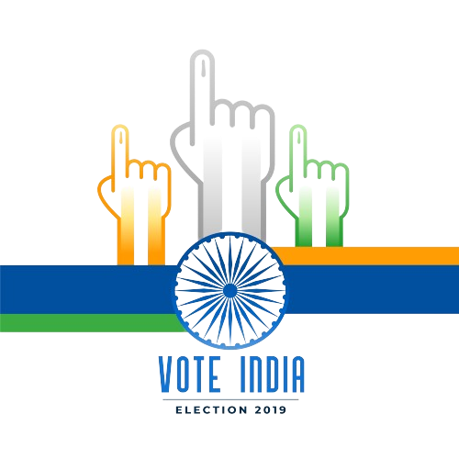


Data Analysis Project on Lok Sabha Election 2014 & 2019
A Comparative Study
CodeBasics Resume Project Challenge #11
~Rahul Kumar

Slide 2
Content
Introduction
Data Sources
Voter Turnout
Seat Distribution
Party Performance
Regional Analysis
Margin of Victory
Key Insights
Challenges and Limitations
Conclusion

Slide 3
Introduction
This data analysis project aims to provide a comprehensive comparison between the 2014 and 2019 Lok Sabha elections. By analyzing voter turnout, seat distribution, party performance, and regional trends, we seek to uncover the key factors that influenced the election outcomes and the changes in the political scenario over these five years.
Scope:
Voter Turnout: Analysis of the number of voters who participated in the elections and the trends observed.
Seat Distribution: Comparison of the number of seats won by major parties in both elections.
Party Performance: Detailed analysis of how major parties like BJP and INC performed in terms of seats won and vote share.
Regional Analysis: Examination of election results on a state-by-state basis to identify regional strongholds and shifts.
Trends and Patterns: Identification of key trends, such as demographic voting patterns and the impact of campaign strategies.

Slide 4
Data Sources
Primary Source: Codebasic & Election Commission of India
Additional Sources: Data.gov.in, news reports, analytical articles
This project leverages data from the Election Commission of India, supplemented by other credible sources, to ensure a thorough and accurate analysis.

Slide 5
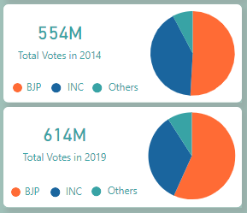
Voter Turnout
2014: 554 million total votes
2019: 614 million total votes

Slide 6
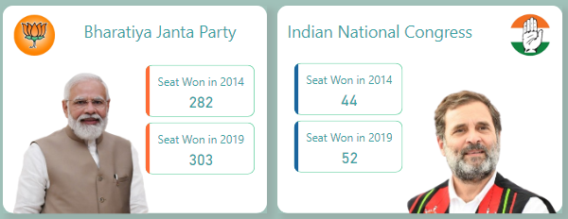
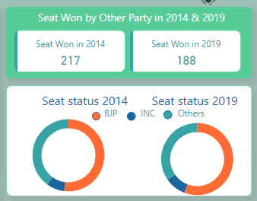
Seat Distribution
2014 Results:
BJP: 282 seats
INC: 44 seats
Others: 217 seats
2019 Results:
BJP: 303 seats
INC: 52 seats
Others: 188 seats

Slide 7
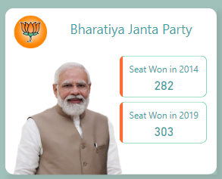
Party Performance (BJP)
2014 Performance:
Total Seats: 282
2019 Performance:
Total Seats: 303

Slide 8
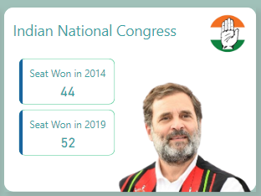
Party Performance (INC)
2014 Performance:
Total Seats: 44
2019 Performance:
Total Seats: 52

Slide 9
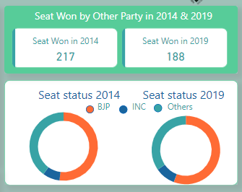
Party Performance (Others)
2014 Performance:
Total Seats: 217
2019 Performance:
Total Seats: 188

Slide 10
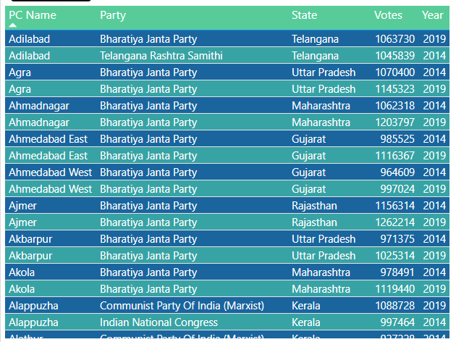

Slide 11
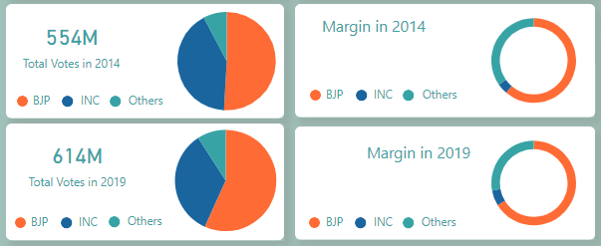
Margin of Victory

Slide 12
Key Insights
The analysis of the 2014 and 2019 Lok Sabha elections reveals several critical insights into the political dynamics and voter behavior in India. These insights not only highlight the factors behind the success of the major parties but also indicate the evolving landscape of Indian politics.
Success Factors for BJP:
Strategic Campaigning: The Bharatiya Janata Party (BJP) employed effective and innovative campaign strategies, leveraging technology and social media to reach a wider audience.
Leadership Appeal: The strong leadership and charismatic appeal of Narendra Modi played a pivotal role in both elections, garnering widespread support.
Development Agenda: The focus on development and governance resonated well with the voters, particularly in urban and semi-urban areas.
Coalition Building: Successful alliances with regional parties helped consolidate BJP's position in several key states.

Slide 13
Challenges for INC:
Leadership Issues: The Indian National Congress (INC) faced challenges related to leadership, which affected its ability to connect with voters effectively.
Campaign Effectiveness: Compared to the BJP, the INC's campaign strategies were less impactful, particularly in terms of leveraging digital platforms.
Regional Presence: The party struggled to maintain a strong regional presence, losing significant ground in several key states.
Voter Trust: Issues related to corruption and governance in previous years impacted voter trust in the party.
3. Role of Regional Parties:
Influence on Results: Regional parties played a crucial role in the overall election results, particularly in states like West Bengal, Tamil Nadu, and Uttar Pradesh.
Shifts in Alliances: Changes in alliances and coalition dynamics significantly influenced the election outcomes in various states.
Voter Base: Regional parties were able to maintain a strong voter base by addressing local issues and concerns more effectively.

Slide 14
Voter Turnout and Engagement:
Increased Turnout: The increase in voter turnout from 554 million in 2014 to 614 million in 2019 indicates a growing engagement and participation in the democratic process.
Youth Participation: A notable rise in the participation of young voters, who were influenced by social media and digital campaigns.
Urban vs. Rural Dynamics: Differences in voting patterns between urban and rural areas, with urban voters showing more support for development agendas and rural voters influenced by local issues.
5. Emerging Trends:
Digital Campaigning: The 2019 elections saw a significant shift towards digital campaigning, with parties using social media, targeted advertising, and data analytics to reach voters.
Issue-based Voting: Voters showed a tendency to vote based on specific issues like development, employment, and governance rather than traditional party loyalty.
Polarization: Increased polarization on ideological lines, with clear divides in voter preferences based on regional, religious, and community identities.

Slide 15
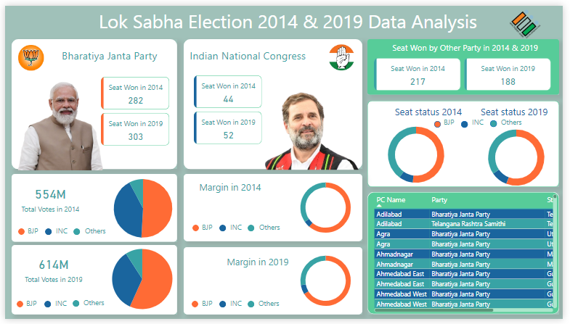
These insights provide a comprehensive understanding of the factors that influenced the Lok Sabha elections of 2014 and 2019, highlighting the evolving nature of Indian politics and voter behavior.

Slide 16
Thank You

